Slide 1

UNITED NATIONS GLOBAL GEODETIC
CENTRE OF EXCELLENCE
MODERNISING GEOSPATIAL REFERENCE SYSTEM
CAPACITY DEVELOPMENT WORKSHOP
Governance
Nicholas Brown
UN-GGCE
Day 4, Session 3 [4_3_1]
Acknowledgements: Johannes Bouman (GER); Anna Riddell (AUS)

Slide 2


Overview
Governance and institutional arrangements present a clear division of roles and responsibilities among organizations involved in geospatial information management, and the formal and informal structures of cooperation and collaboration between and among organizations.

Slide 3
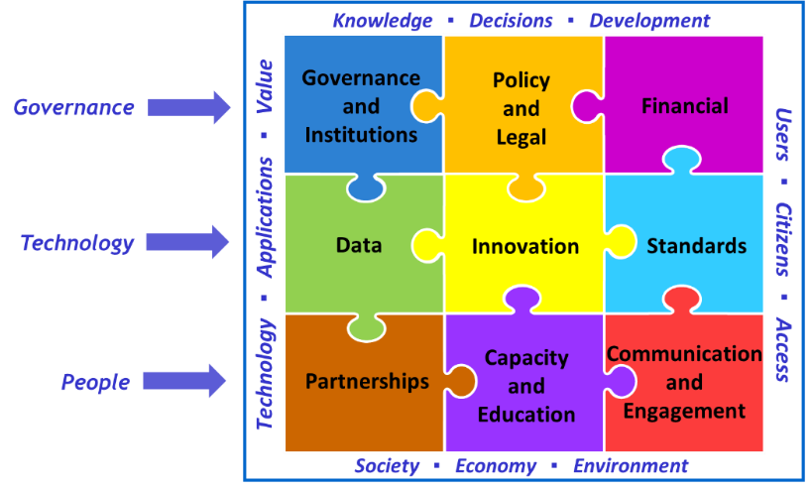
Governance in the IGIF

Slide 4
Importance of governance
Good governance is crucial for the development of a country’s Geospatial Reference System (GRS) because it ensures that the GRS is accurate, sustainable, widely adopted, and effectively managed. Governance related issues to be considered include:
Strategy, Policy and Legal Framework: Policies, standards, and regulations that define its use, data sharing, and integration with other national systems. Examples include:
      2020 – Australia – The Spatial Information Council for Australia and New Zealand announced that member agencies in Australian states and territories will be ready to deliver and receive foundation spatial data on the Geocentric Datum of Australia (GDA2020) datum. This is recognised in the Australian National Measurement (Recognized-Value Standard of Measurement of Position) Determination 2017.
      2021 - Kingdom of Saudi Arabia - the General Authority for Survey and Geospatial Information (GEOSA) Board of Directors, approved the widespread adoption of Saudi Arabia National Spatial Reference System (SANSRS) for surveying operations and geospatial data management. This decision underscores the importance of a unified geospatial framework for national projects.
Compliance with international standards: Good governance promotes data policies, making geospatial data widely available for businesses, researchers, and policymakers. This drives economic growth, innovation, and informed decision-making.
International Collaboration and Compliance: A country GRS should align with global standards and this requires coordination with international bodies for data sharing and interoperability. Governance structures often include mechanisms for engaging in international forums and adopting relevant international agreements, such as those provided by the United Nations Initiative on Global Geospatial Information Management (UN-GGIM).

Slide 5
Importance of governance
Coordination and collaboration: The implementation or modernisation of a GRS involves multiple stakeholders, including government agencies (e.g., land management, transportation, defence, environmental agencies), private sector, indigenous groups and academia. Well-designed governance structures enable coordination and collaboration among these stakeholders, preventing data duplication and ensuring interoperability.
Funding and sustainability: Developing and maintaining a GRS requires funding for initial implementation, and ongoing funding for sustainability. Good governance ensures decision makers understand the need for ongoing funding, sustainable investment, transparent budgeting, and accountability.
Awareness across government: A robust GRS supports disaster response, urban planning, infrastructure development, and national security. Governance ensures awareness of the importance of the GRS across government and engagement with communities who rely the GRS.
Risk management: Programs of this size, with broad and complex stakeholder engagement have inherent risk. Good governance is required to ensure risks are known and mitigated effectively.

Slide 6
Groups to consider
The national geodetic or geospatial authority or agency is often the lead agency responsible for overseeing the development, maintenance, and implementation of the national GRS. The lead national geodetic or geospatial authority or agency should collaborate and communicate with:
Land management authorities: Engaging land management authorities ensures alignment with existing regulations, land use policies, and legal frameworks. Their expertise helps improve data accuracy, resource planning, and infrastructure development by integrating official cadastral and land tenure information. Collaboration also enhances system interoperability, reduces conflicts over land boundaries, and supports sustainable land governance.
Water authorities: Engaging water authorities ensures accurate mapping of water resources, infrastructure, and hydrological systems for effective management. Their input helps in monitoring water quality, flood risk, and watershed boundaries, supporting sustainable water use and disaster resilience. Collaboration also improves data integration for regulatory compliance, resource allocation, and long-term water security planning.

Slide 7
Groups to consider
Defence Department: Engaging defence departments ensures national security considerations are integrated, preventing unauthorized access to sensitive geospatial data. Their expertise enhances system resilience, accuracy, and interoperability for defence operations, emergency response, and strategic planning. Collaboration also helps align the GRS with defence infrastructure, surveillance needs, and international security standards.
Air Services: Engaging air services ensures accurate mapping of airspace, flight routes, and aviation infrastructure for safe and efficient air traffic management. Their expertise helps integrate aeronautical data, navigation aids, and regulatory requirements, reducing risks and improving situational awareness. Collaboration also enhances interoperability with global aviation systems, supports compliance with international standards, and facilitates seamless airspace coordination.
Maritime Services: Engaging maritime services ensures accurate mapping of coastal areas, shipping routes, and maritime boundaries for safe and efficient navigation. Their expertise helps integrate hydrographic data, tidal information, and regulatory requirements to prevent maritime accidents and support sustainable ocean resource management. Collaboration also enhances interoperability with global navigation systems, ensures compliance with international maritime standards, and improves coastal resilience against environmental risks.

Slide 8
Groups to consider
Space agency: Engaging the national space agency ensures the integration of high-precision satellite data for accurate mapping and monitoring of geographic features. Their expertise in remote sensing, satellite navigation, and geospatial technologies enhances system accuracy, scalability, and global compatibility. Collaboration also supports compliance with space regulations, fosters innovation in geospatial technologies, and strengthens national capabilities in space-based resource management.
Standards: Engaging with standards bodies ensures compliance with internationally recognized protocols, facilitating data interoperability and consistency across systems. Their guidance helps establish best practices for data quality, metadata standards, and system integration, promoting seamless collaboration across sectors. Collaboration with standards bodies (including International Organization for Standardization (ISO) or the Open Geospatial Consortium (OGC)) also supports the long-term sustainability of the GRS by aligning it with evolving global geospatial standards and regulations.
Data Stewardship: Data stewards ensure data quality, security, and availability, and they are responsible for metadata and data dissemination. Responsibility for specific datasets may be assigned to agencies or organizations best suited to manage them. For example, national mapping agencies might be the custodian of geodetic data, while environmental agencies handle data related to ecosystems or natural resources.

Slide 9
Groups to consider
Metrology: Engaging with metrology agencies ensures the accuracy and precision of measurements, particularly in positioning and calibration of geospatial data. Their expertise is crucial in the legal determination of the datum, ensuring that it aligns with recognized national and international measurement standards. Collaboration with metrology agencies also supports reliable benchmarks, consistency, and traceability, enhancing the credibility and legal validity of the GRS.
Policy and regulatory: Legal frameworks are crucial for establishing rights and obligations regarding geospatial data collection, use, and sharing. This includes ensuring compliance with data protection laws, intellectual property rights, and international agreements. Additionally, these frameworks help prevent misuse of data, including ensuring transparency and preventing corruption in data collection and use.
Funders and donors: The establishment and sustainment of a GRS needs adequate financial and technical resources to be developed and maintained. Governance structures should define how funding is allocated for the development of infrastructure, research, and training related to GRS, ensuring long-term sustainability.

Slide 10
Groups to consider
Capacity development and education: Engaging with capacity development and education organizations ensures that stakeholders are trained in the system's use, fostering widespread adoption and technical expertise. Their involvement helps build long-term skills and knowledge, ensuring sustainability and effective implementation of the GRS across diverse sectors. Collaboration also supports the development of educational materials and training programs, ensuring that the GRS is accessible and usable by future generations of professionals.
Indigenous communities: Engaging Indigenous communities ensures respect for their land rights, integrates valuable traditional knowledge, and enhances mapping accuracy. It also aligns with legal and ethical standards, supports data sovereignty, and prevents misuse of Indigenous land data. Meaningful collaboration fosters trust, promotes long-term partnerships, and leads to more inclusive and sustainable geospatial solutions.

Slide 11
Structure
Below is a sample governance structure for the establishment and operationalization of a country’s GRS along with a brief description of the role of each committee (or subcommittee) in the structure. It is advisable that you consider the range of groups to determine who should participate in the committees and working groups.
Steering Committee
Implementation Committee
Working Group A
Working Group B
Working Group C
Notes:
A Steering Committee provides strategic oversight, setting the direction and ensuring that the overall goals and objectives of a project or system are met. The Implementation Committee focuses on the practical execution, managing resources, timelines, and ensuring that tasks are carried out according to the plan. Working Groups, often led by members of the Implementation Committee, focus on specific tasks or thematic areas within the project, providing expertise and detailed work in line with the broader strategy set by the Steering Committee.

Slide 12
Influence and Interest
High Influence and Low Interest
Meet their needs
Try and increase level of interest
e.g. industry (private sector, geospatial industry)
INVOLVE AND COLLABORATE
High Influence and High Interest
Key players
Involve in governance
Engage and consult regularly
e.g. government (defence, policy and science agencies)
e.g. scientific community
KEEP SATISFIED
Influence
Low Influence and Low Interest
Inform via general communications, newsletters and website
e.g. general public
KEEP INFORMED
Low Influence and High Interest
Keep informed and consult on interest area
Potential supporter or ambassador
e.g. user community from government, academia and industry
CONSULT
Interest

Slide 13

International governance
United Nations Global Geospatial Information Management Committee of Experts
  ECOSOC established the Committee of Experts as the apex intergovernmental mechanism for making joint decisions and setting directions with regard to the production, availability and use of geospatial information within national, regional and global policy frameworks. Led by United Nations Member States, UN-GGIM aims to address global challenges regarding the use of geospatial information, including in the development agendas, and to serve as a body for global policymaking in the field of geospatial information management.

Slide 14
International governance
High-level Group
1. High-level Group of the Integrated Geospatial Information Framework
Subcommittee
1. Subcommittee on Geodesy (formerly WG on Global Geodetic Reference Frame)
Expert Groups
1. Expert Group on the Integration of Statistical and Geospatial Information
2. Expert Group on Land Administration and Management
Working Groups
1. Working Group on Geospatial Information for Disaster Risk Management
2. Working Group on Policy and Legal Frameworks for Geospatial Information Management
3. Working Group on Marine Geospatial Information
Task Teams
1. Task Team on Geospatial Information for Climate Resilience
2. Writing Team on the Future Geospatial Information Ecosystem
Working Group of the IAEG-SDGs
Working Group on Geospatial Information
Past Working Groups
1. Working Group on Development of a Statement of Shared Principles for the Management of Geospatial Information
2. Working Group on Trends in National Institutional Arrangements in Geospatial Information Management
3. Working Group on Global Fundamental Geospatial Data Themes

Slide 15
International governance
The UN-Resolution A Global Geodetic Reference Frame for Sustainable Development (GGRF) was adopted by the UN General Assembly on 26.02.2015
  Need stronger global commitment
  For science and society
  No funding allocated

Slide 16
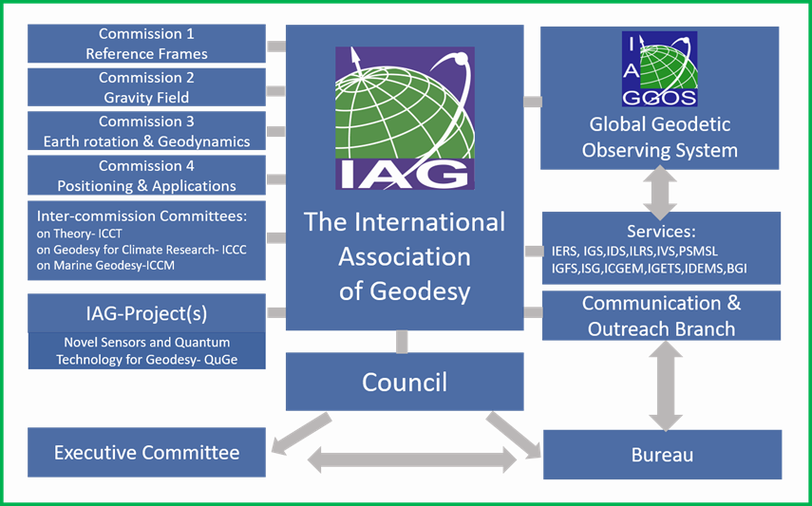
International governance
Geodesy Capacity Development Workshop​
Notes:
Under the umbrella of the IAG international services have been established, which coordinate geodetic observations and create the spatial reference products (ITRF, EOPs, Gravity Field, ...)

Slide 17



International governance
Geodesy Capacity Development Workshop​
Notes:
Under the umbrella of the IAG international services have been established, which coordinate geodetic observations and create the spatial reference products (ITRF, EOPs, Gravity Field, ...)

Slide 18
International governance
What are we missing?
  Dedicated resources
  Capital funding
  Operating funding
  Global work plan
  Risk assessment
  …
Geodesy Capacity Development Workshop​
Notes:
Under the umbrella of the IAG international services have been established, which coordinate geodetic observations and create the spatial reference products (ITRF, EOPs, Gravity Field, ...)

Slide 19
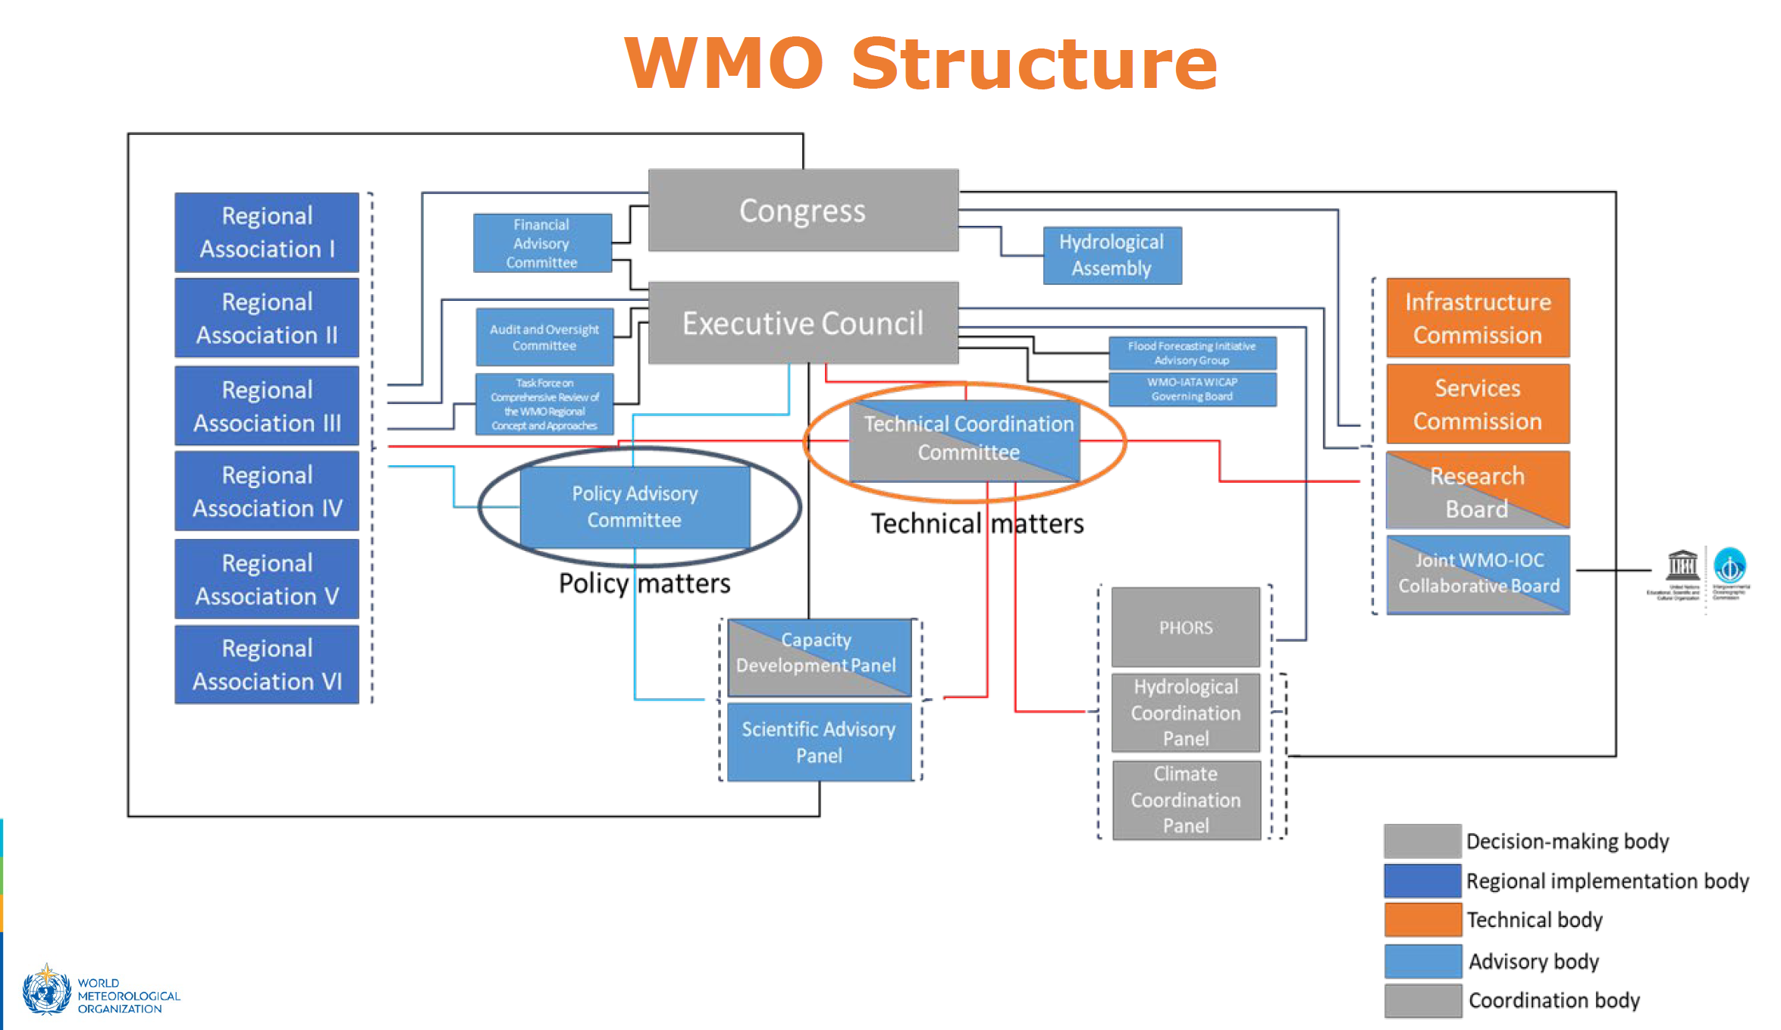
Examples to copy
Geodesy Capacity Development Workshop​
Notes:
Under the umbrella of the IAG international services have been established, which coordinate geodetic observations and create the spatial reference products (ITRF, EOPs, Gravity Field, ...)

Slide 20
Case Study 1: Germany
Geodesy Capacity Development Workshop​

Slide 21
Country governance (contributors)
Alfred-Wegener-Institut für Polar- und Meeresforschung (AWI)
Arbeitsgemeinschaft der Vermessungsverwaltungen der Länder der Bundesrepublik Deutschland (AdV)
Bundesamt für Kartographie und Geodäsie (BKG)
Bundesamt für Seeschifffahrt und Hydrographie (BSH)
Bundesanstalt für Gewässerkunde (BfG)
Deutsches Geodätisches Forschungsinstitut (DGFI-TUM)
Deutsches GeoForschungsZentrum (GFZ)
Deutsches Luft- und Raumfahrtzentrum (DLR)
Deutscher Verein für Vermessungswesen (DVW)
European Space Operations Centre (ESA/ESOC)
HafenCity Universität Hamburg (HCU)
Karlsruher Institut für Technologie (KIT)
Kommission für Erdmessung und Glaziologie (KEG)
Leibniz Universität Hannover
Rheinische Friedrich-Wilhelms-Universität Bonn
Technische Universität Dresden
Technische Universität München (TUM)
Universität Stuttgart
Zentrum für Geoinformationswesen der Bundeswehr (ZGeoBw)
Agency (Federal, Space, State) Research Institute University

Slide 22
Country governance (users)
Universities and Universities of Applied Sciences
FH Biberach: Labor für Vermessungswesen, HU Berlin: Geographisches Institut, Uni Hannover: Der Studiengang Geodäsie und Geoinformatik, Uni Siegen: Fakultät für Bauingenieurwesen, Hochschule (HS) , Karlsruhe: Fakultät für Geoinformationswesen, TU Berlin: Bauingenieurwesen und Geowissenschaften, FH Oldenburg: Die Abteilung Geoinformation, Bergische Universität Wuppertal: Fakultät für Bauingenieurwesen, Karlsruher Institut für Technologie (KIT): Fakultät Bau - Geo – Umwelt, TU Cottbus: Fakultät für Architektur, Tiefbau und städtischen Design, Uni Vechta: Umweltwissenschaften, Räumliche Analyse und Planung, FH Mainz: Vermessungswesen und Geoinformatik, FH Stuttgart: Geomatics; Luftfahrttechnik und Geodäsie, HafenCity Universität Hamburg: Geodäsie und Geoinformatik, RWTH Aachen: Fakultät für Bauingenieurwesen, Uni Trier: Geographie / Geowissenschaften, FH München: Fachbereich Geoinformationswesen, TU Darmstadt: Geodäsie und Geoinformation, Ruhr-Universität Bochum: Bau-ingenieurwesen, Geograph. Institut, HTW Dresden: Fachbereich Vermessungswesen / Kartographie, TU München: Geodäsie und Geoinformation, FH Frankfurt: Fakultät für Vermessungswesen, FH Bochum: Vermessungswesen und Geoinformatik, TU Dresden: Fakultät für Forst-, Geo-, und Hydrowissenschaften, Uni-BW München: Geodäsie und Geoinformation, FH Neubrandenburg: Vermessungswesen, Geoinformatik, TFH Georg Agricola: Vermessung und Liegenschaftsmanagement, TU Freiberg: Fakultät für Geowis., Geotechnik und Bergbau, FH Würzburg: Institut für Vermessung und Geoinformation, Uni Rostock: Agrar- und Umweltwissenschaftliche Fakultät, Uni Bonn: Studiengang Geodäsie und Geoinformation, FH Anhalt: Institut für Vermessungswesen, FU Berlin: Institut für Geographische Wissenschaft, TU Braunschweig: Bauingenieurwesen, Uni/GHS Essen: Institut für Vermessungswesen, FH Magdeburg: Fakultät für Bauwesen, TFH Berlin: Bauingenieur- und Geoinformationswesen, TU Clausthal: Institut für Geotechnik und Markscheidewesen, Uni Münster: Institut für Geowissenschaften, Uni Weimar: Fakultät für Bauingenieurwesen
Agencies, Research Institutes, Others
Alfred-Wegener-Institut für Polar- und Meeresforschung (AWI), Bremerhaven, Deutscher Dachverband für Geoinformation e.V. (DDGI), Deutsches GeoForschungsZentrum (GFZ), Arbeitsgemeinschaft Vermessungsverwaltungen der Länder (AdV), Deutsche Geodätische Kommission (DGK), Geounion Alfred-Wegener-Stiftung, Kommission für Erdmessung und Glaziologie (KEG), München, Deutsche Gesellschaft für Geographie (DGfG), Institut für Kommunale Geoinformationssysteme e.V., Beratungsgruppe für Internationale Entwicklung im Vermessungswesen (BEV), Deutsche Gesellschaft für Kartographie (DGfK), Kompetenzzentrum für Geoinformatik (GiN), Bund der Öffentlich bestellten Vermessungsingenieure (BDVI), Deutsche Gesellschaft für Photogrammetrie, Fernerkundung und Geoinformation, Nationales Komitee für Geodäsie und Geophysik (NKGG), Bundesamt für Kartographie und Geodäsie (BKG), Frankfurt a.M., Leipzig, Wettzell, Deutsches Luft- und Raumfahrtzentrum (DLR), Raumwissenschaftliches Kompetenzzentrum Dresden, Bundesamt für Seeschifffahrt und Hydrographie (BSH), Rostock, Deutscher Verein für Vermessungswesen (DVW), Universitäres Zentrum für Luft- und Raumfahrt - Technische Universität Dresden, Bundesanstalt für Gewässerkunde (BfG), Koblenz, Fachkomm. "Kommunales Vermessungs- und Liegenschaftswesen" im Deutschen Städtetag, Verband deutscher Vermessungsingenieure (VdV), Bund-Länder-Arbeitsgemeinschaft Landentwicklung, Förderkreis Vermessungstechnisches Museum e.V., Dortmund, Zentrum für Geoinformationswesen der Bundeswehr (ZGeoBw)
Geodesy Capacity Development Workshop​
Geodesy Capacity Development Workshop​

Slide 23
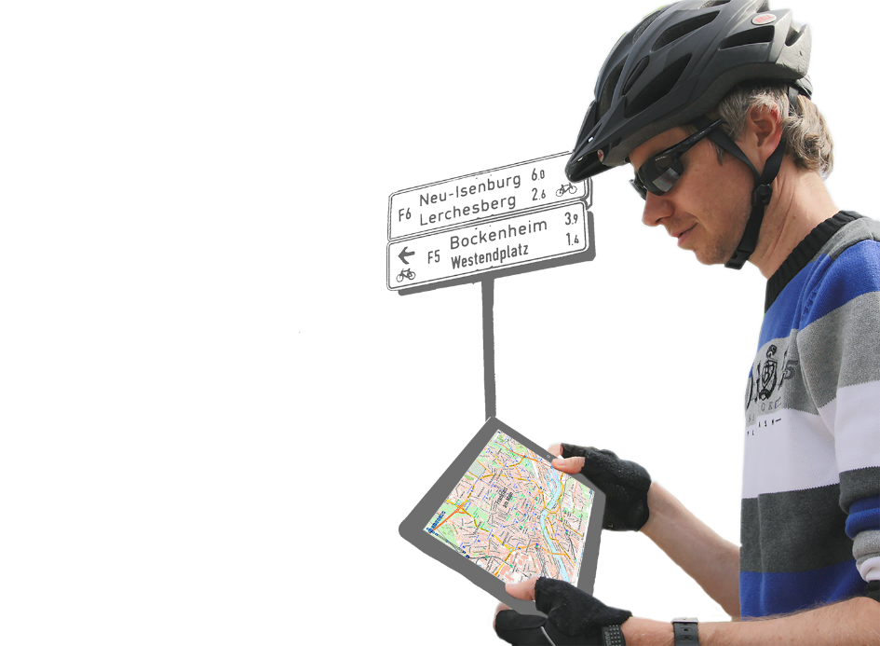
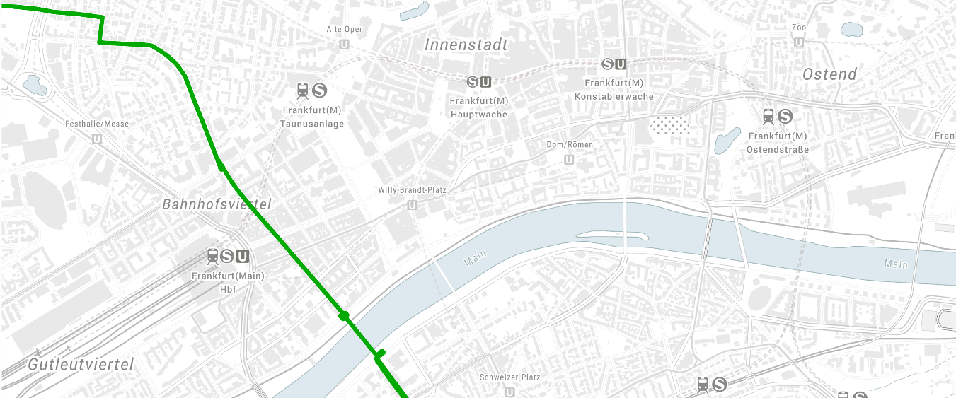
Country governance (BKG)
Germany’s National Mapping Agency under the Federal Ministry of the Interior and Community
Central service provider of geodetic reference systems and networks, as well as geotopographic reference data for the German federal government
Representative of Germany's interests in geodesy and geospatial information at European and international level
Providers of training in the professions of geomatics technician and precision mechanic
www.bkg.bund.de
Geodesy Capacity Development Workshop
Geodesy Capacity Development Workshop​

Slide 24
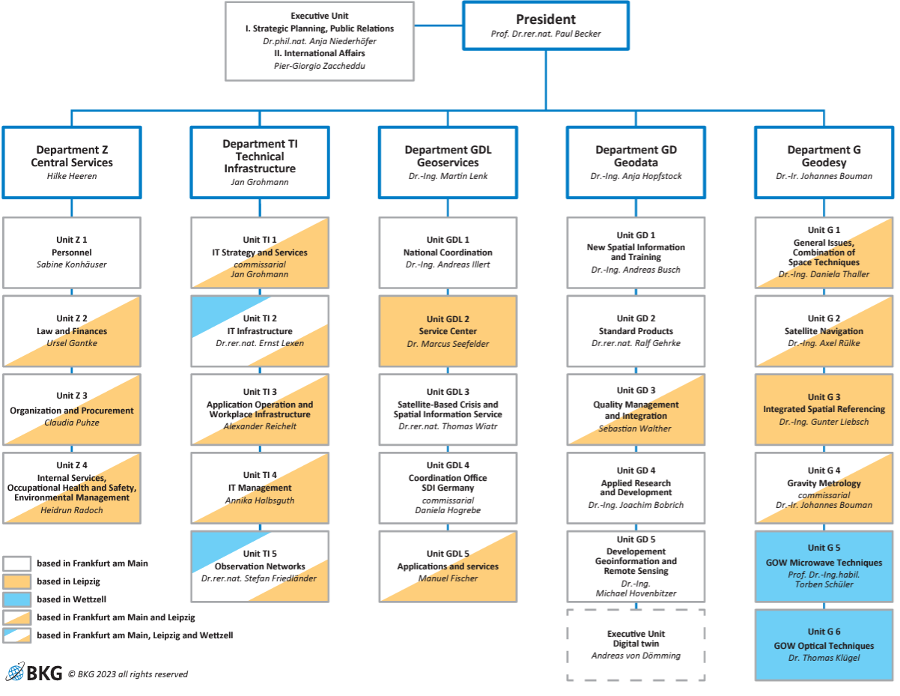
Country governance (BKG)
Geodesy Capacity Development Workshop
Geodesy Capacity Development Workshop​

Slide 25
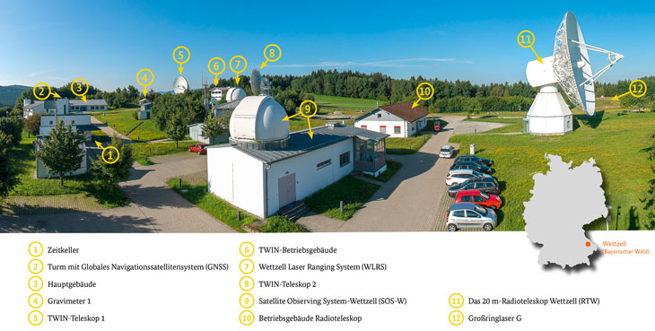
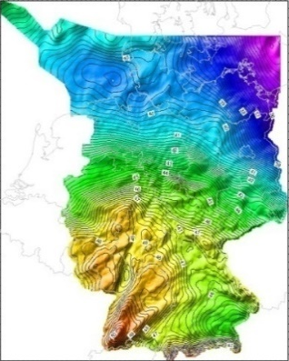
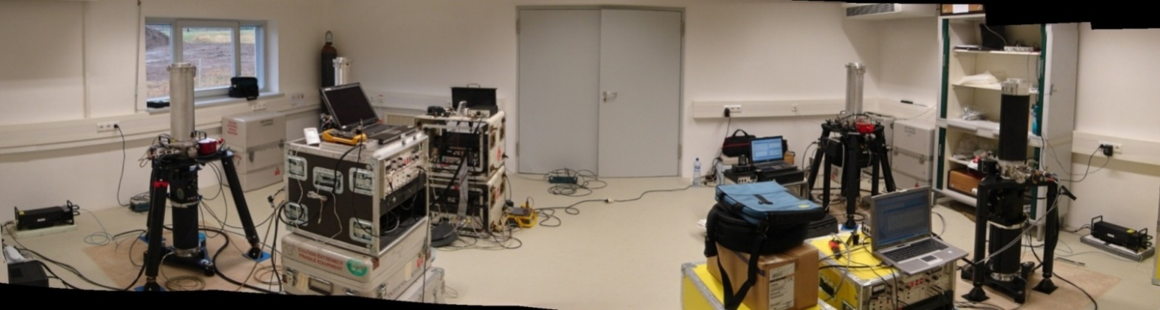

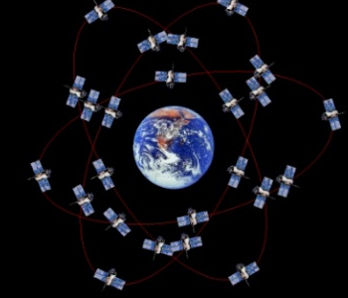
Country governance (BKG)
GOW microwave techniques
VLBI observations
GNSS observations
DORIS observations
Space Weather
GOW optical techniques
SLR/LLR observations
Space Debris
Ringlaser
Local measuring data
Combination of space techniques
Central Office IERS
International VLBI
Service
International Laser
Ranging Service
Combination VLBI,
SLR, GNSS
Satellite
navigation
Real-time positioning
GNSS post-processing
European & national
reference networks
International GNSS
service
Integrated spatial reference
German/European
height reference
Geoid and gravity
field modelling
German reference
network GREF
Satellite altimetry
Gravity
metrology
German gravity
reference system
Absolute gravimetry
Hydro-gravimetry
Superconducting
gravimetry

Slide 26
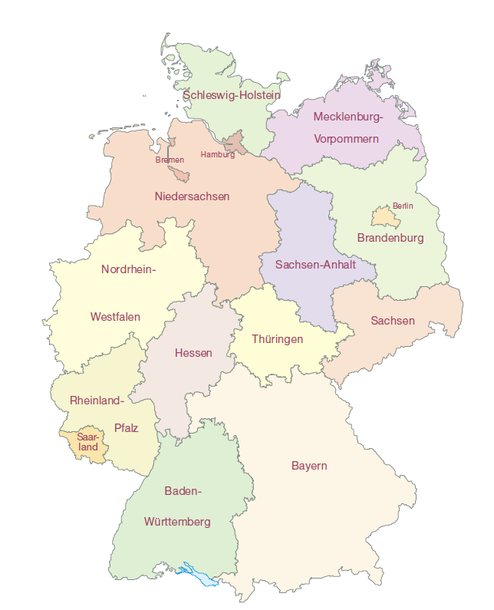
Country governance (BKG)
Responsibilities and legal bases in the surveying sector in Germany
German Federal States (“Laender”)
  Responsible for the national official surveying and cadastral system
Federal Government
  Provision of the overarching geodetic reference systems and networks
  Provision of federal geotopographic reference data
AdV*
  Uniform regulation of technical matters of fundamental and national importance
→ Surveying and cadastral laws
→ Federal Georeference Data Act
(BGeoRG)
Further administrative agreements between the Federal Government and the Laender
* Working Committee of the Surveying Authorities
of the Laender of the Federal Republic of Germany

Slide 27
Case Study 2: Australia

Slide 28

ANZLIC
Country governance (Australia)
Intergovernmental organization providing leadership in the
collection,
management
and use of spatial information in Australia and New Zealand.
Role:
develop policies and strategies to promote accessibility and usability of spatial information
provide a link between government and industry, academia and the general public.

Slide 29
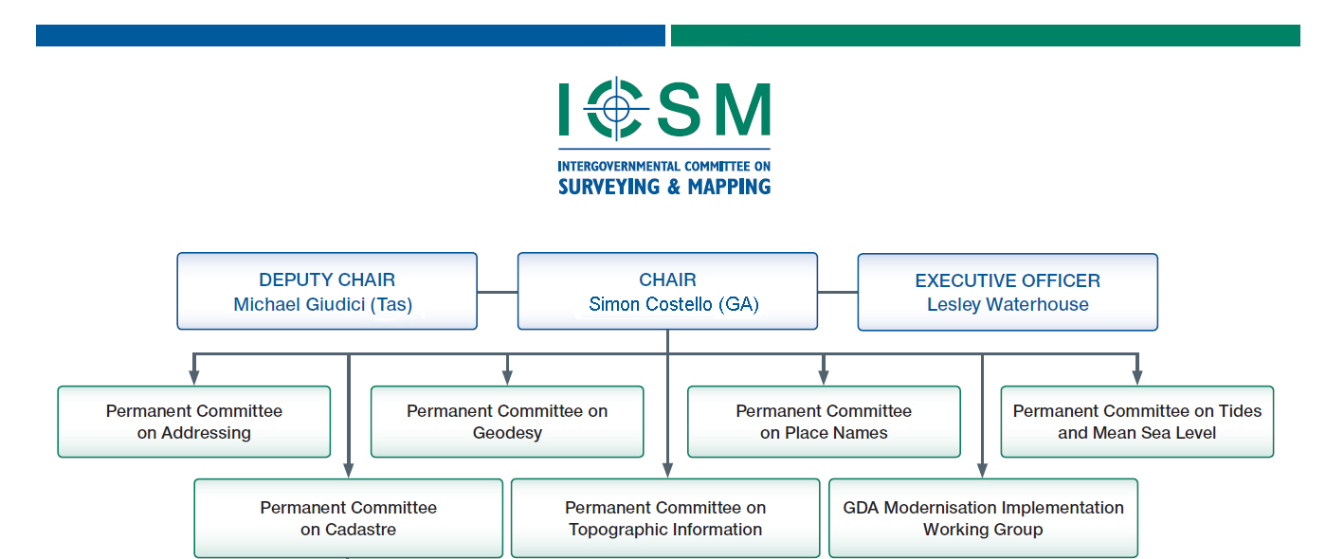

Intergovernmental Committee on Surveying and Mapping
www.sli.do #AGRS

Slide 30
Intergovernmental Committee on Surveying and Mapping
Country governance (Australia)
Representatives from all the Australian states, territories, the Commonwealth and New Zealand.
Members are responsible for government surveying and mapping functions in their jurisdiction.
Coordinate and promote the development and maintenance of key national spatial data including geodetic, topographic, cadastral, street addressing, tides & sea level, and geographical names.
www.sli.do #AGRS

Slide 31
Permanent Committee on Geodesy
Country governance (Australia)
Who: Geodesy, positioning and survey measurement leaders, advisers and advocates from Australian and New Zealand governments (states, territories and Commonwealth) and universities.
What: Provide leadership through coordination and cooperation on the Geospatial Reference Systems of Australia and New Zealand.
www.sli.do #AGRS

Slide 32
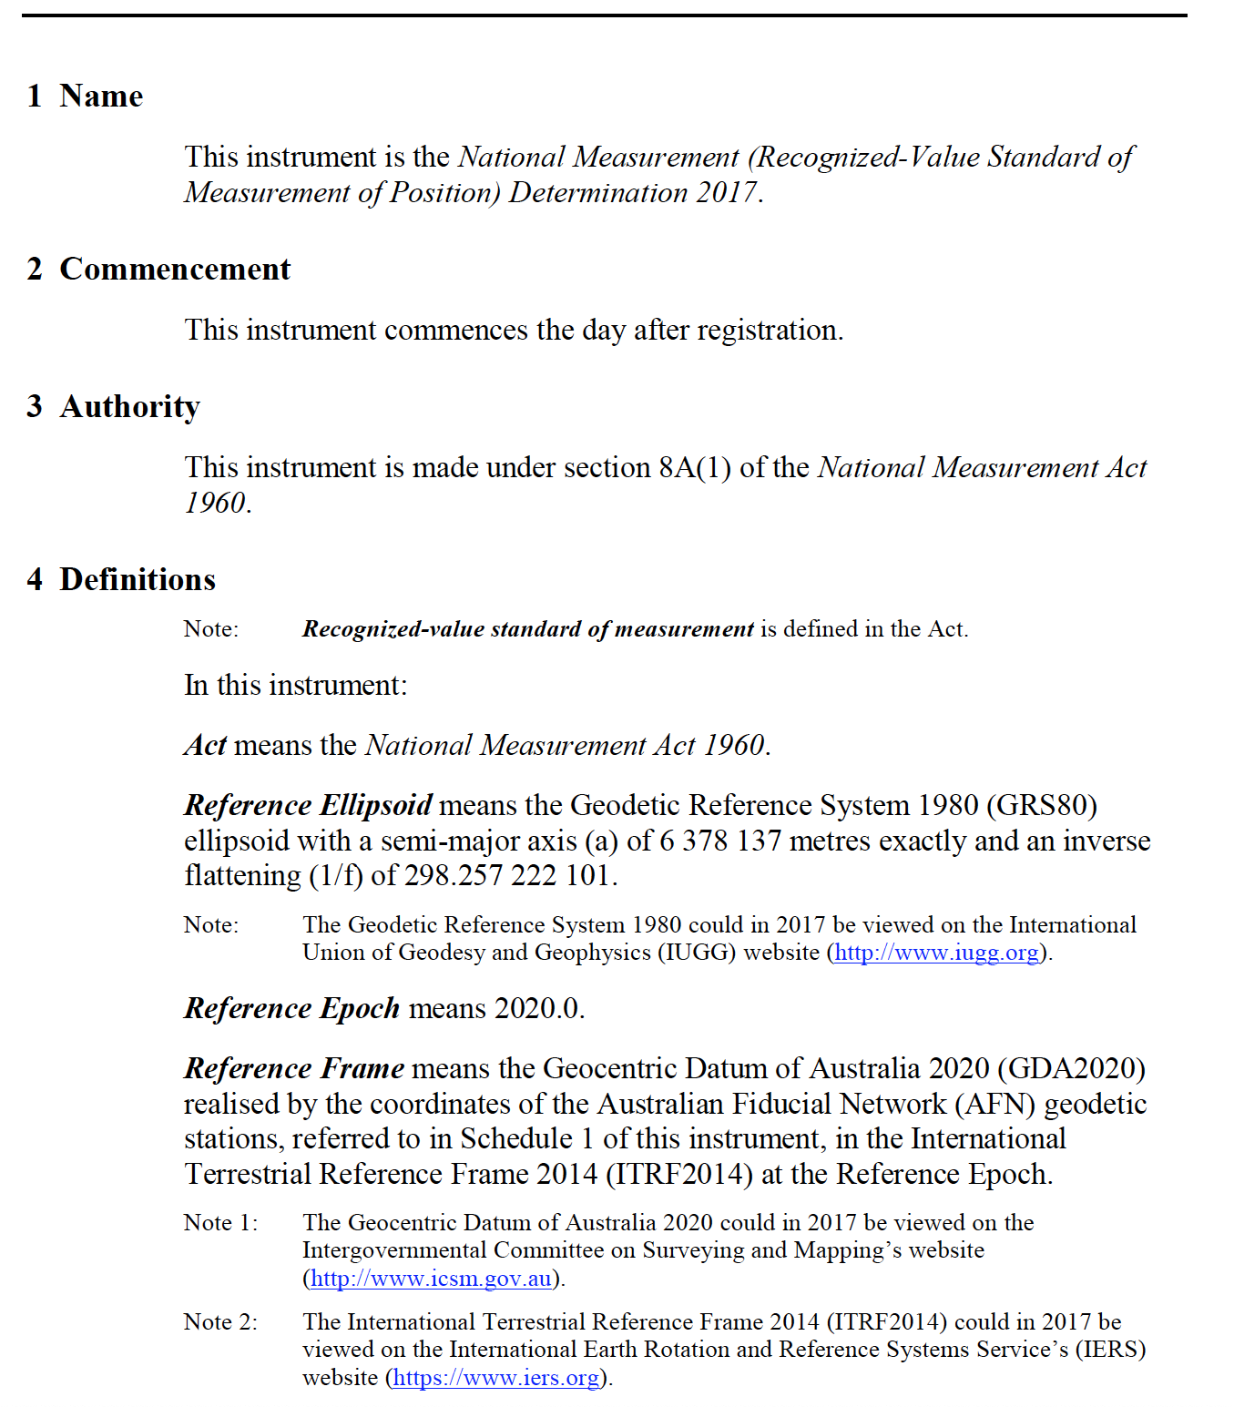
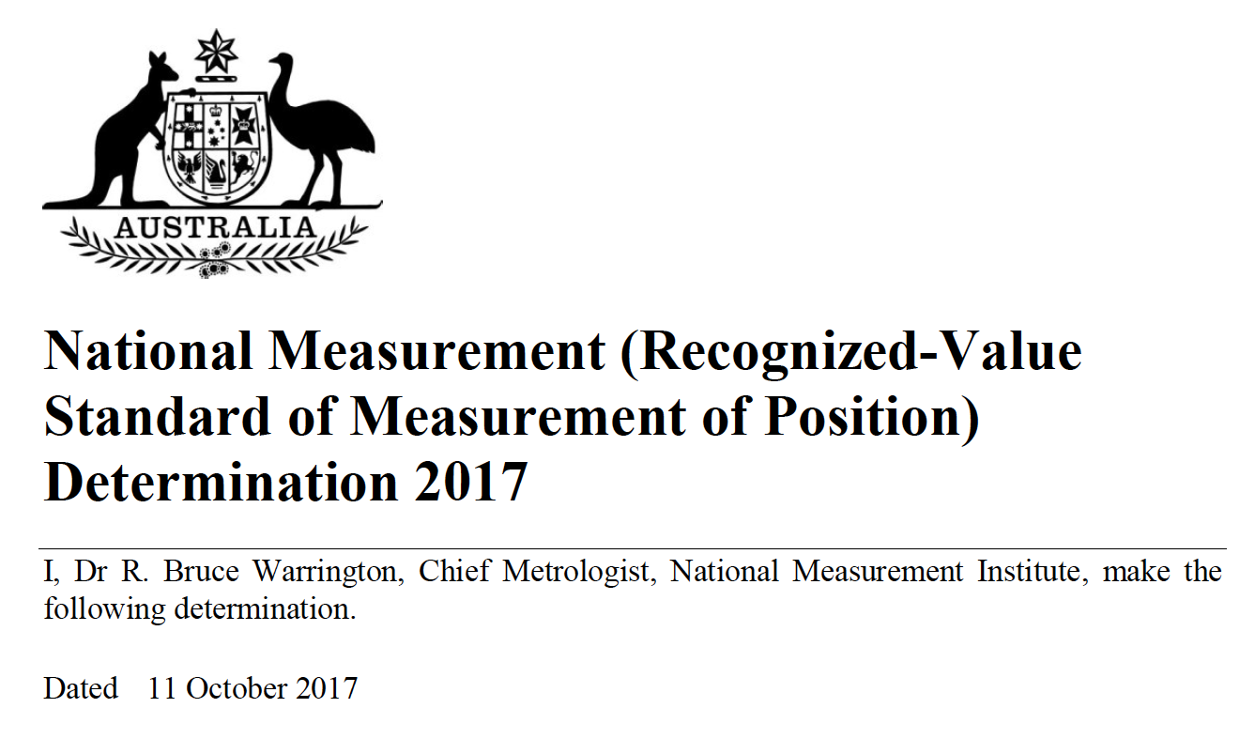
Legislation and regulations
Notes:
A Steering Committee provides strategic oversight, setting the direction and ensuring that the overall goals and objectives of a project or system are met. The Implementation Committee focuses on the practical execution, managing resources, timelines, and ensuring that tasks are carried out according to the plan. Working Groups, often led by members of the Implementation Committee, focus on specific tasks or thematic areas within the project, providing expertise and detailed work in line with the broader strategy set by the Steering Committee.

Slide 33
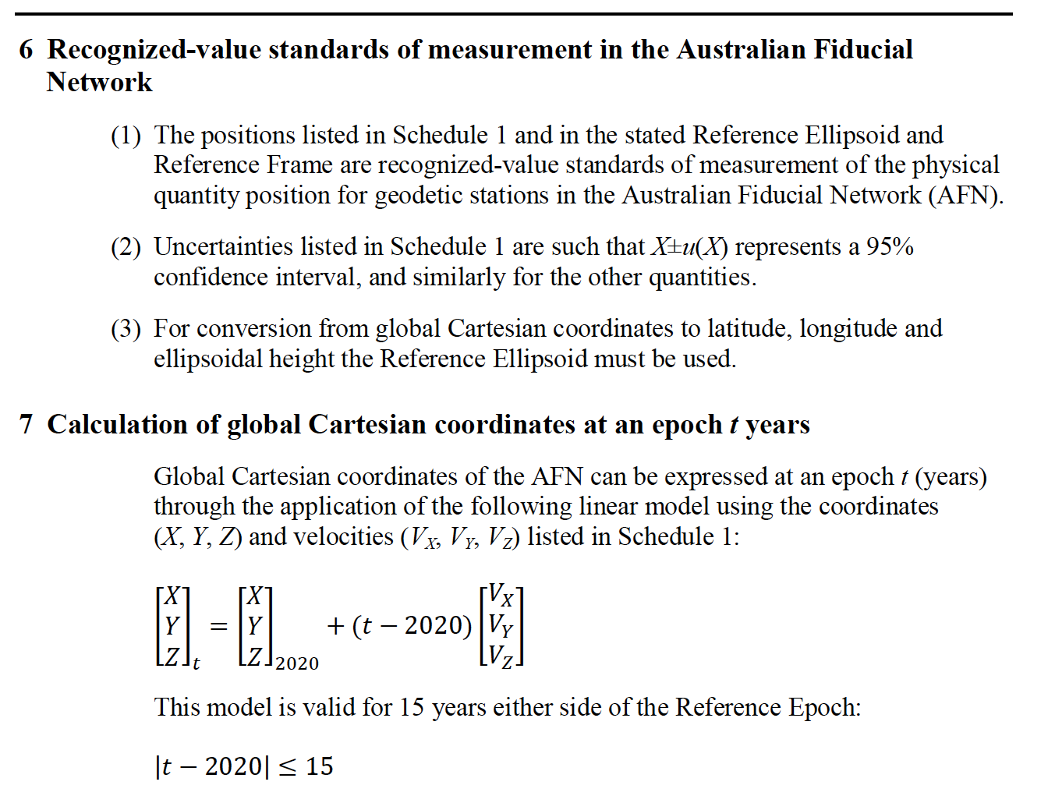
Legislation and regulations
Notes:
A Steering Committee provides strategic oversight, setting the direction and ensuring that the overall goals and objectives of a project or system are met. The Implementation Committee focuses on the practical execution, managing resources, timelines, and ensuring that tasks are carried out according to the plan. Working Groups, often led by members of the Implementation Committee, focus on specific tasks or thematic areas within the project, providing expertise and detailed work in line with the broader strategy set by the Steering Committee.

Slide 34
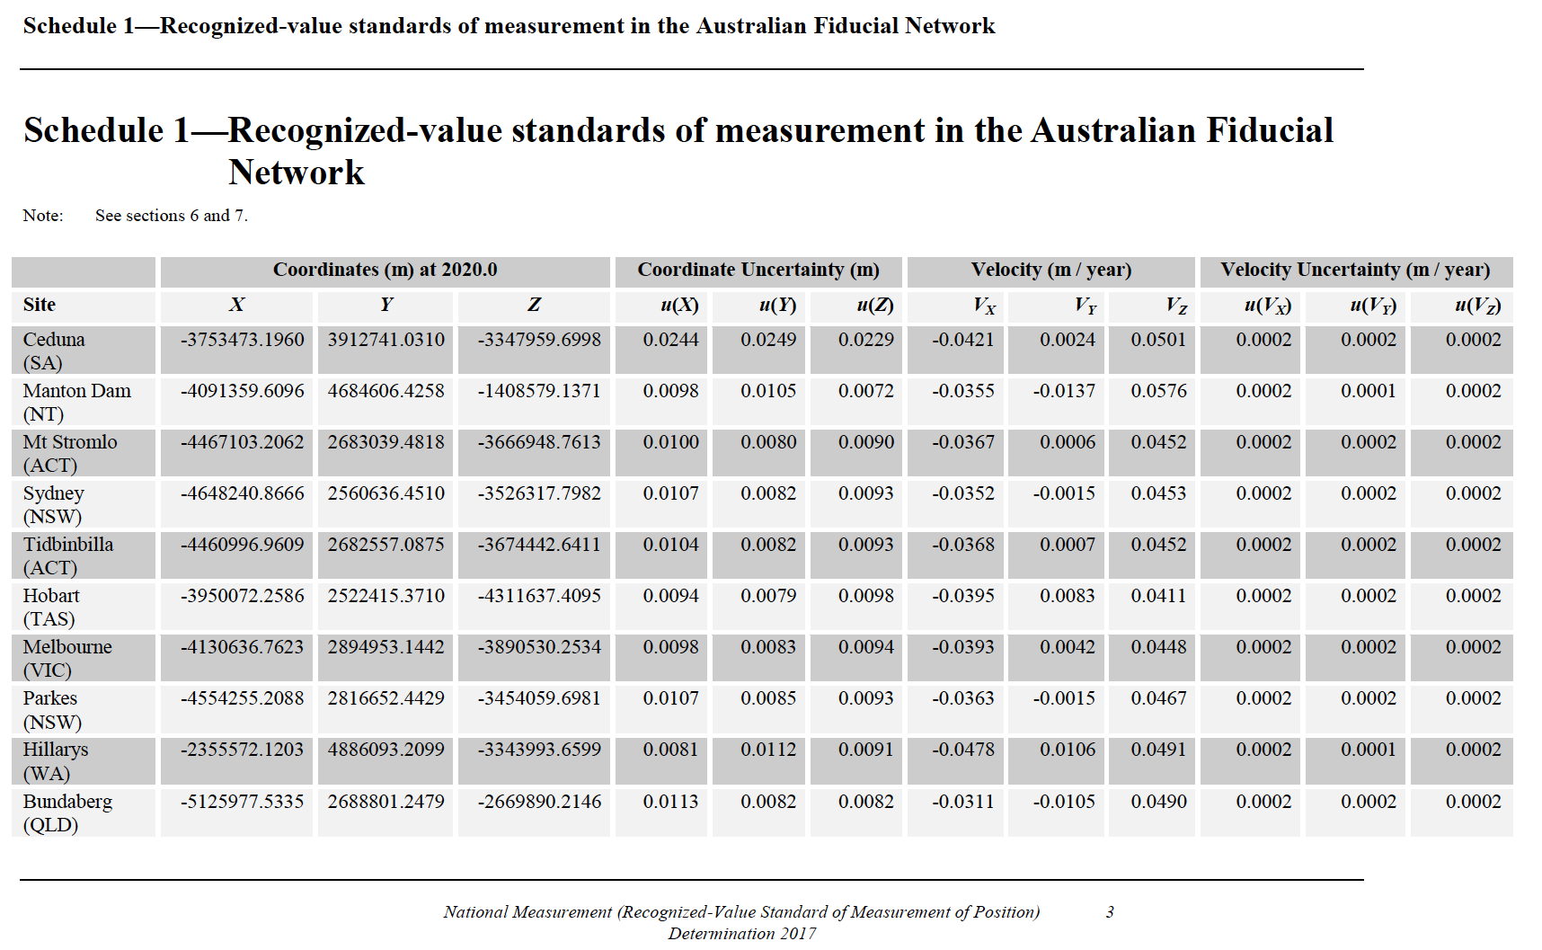
Legislation and regulations
Notes:
A Steering Committee provides strategic oversight, setting the direction and ensuring that the overall goals and objectives of a project or system are met. The Implementation Committee focuses on the practical execution, managing resources, timelines, and ensuring that tasks are carried out according to the plan. Working Groups, often led by members of the Implementation Committee, focus on specific tasks or thematic areas within the project, providing expertise and detailed work in line with the broader strategy set by the Steering Committee.

Slide 35
Summary, Do they have something in common?
International level: strategic
Country-level: implementation
Technical working groups
Notes:
As said before...

Slide 36
Moderated Discussion
Tell me about your country's governance structure
What is similar?
What is different?
What benefits and disadvantages do you see?

